Slide 1

Get Em’ Money
Managing One-Time Payments & Compensation changes in Workday!
Facilitated by:
Pete robertson
Kim japczynski
Nolan Wade

Slide 2

Agenda:
Compensation Changes
  Salary Change
  Hourly Change
  Incentive Rate Change
  Daily Rate Change
One-Time Payments

Slide 3

Objectives:
Become familiar with how one-time payments and compensation changes are processed and executed in Workday.
Review the requirements for salary, hourly, incentive rate, and daily rate adjustments.

Slide 4

Questions ??? – Chat Box
Please post your questions in the chat box which will be monitored and answered in flight.

Slide 5
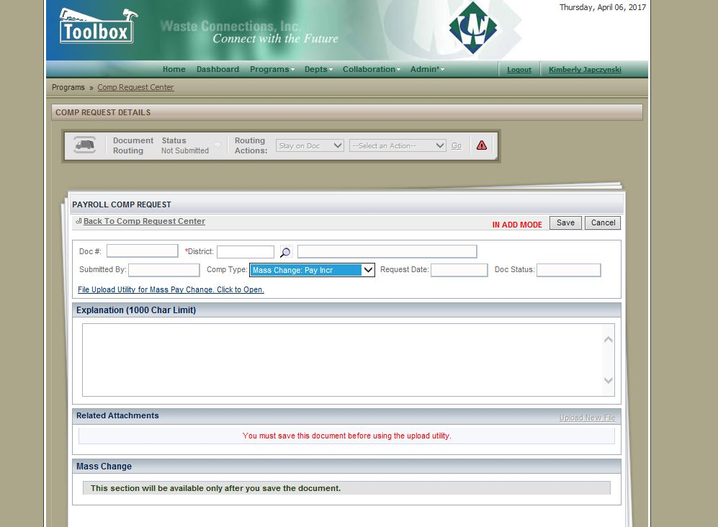
Mass Increases and Bonuses
Increases and bonuses for 15 or more employees should be entered into the Comp Request Tool
Gift cards should only be submitted through the Comp Request Tool as well
Notes:
Mass increases and bonuses for 15 or more employees as well as gift cards should be entered through the Comp Request Tool.

Slide 6

Compensation Changes
Compensation changes occur when an edit is made to an employee’s salary, hourly, incentive, or daily rate.

Slide 7
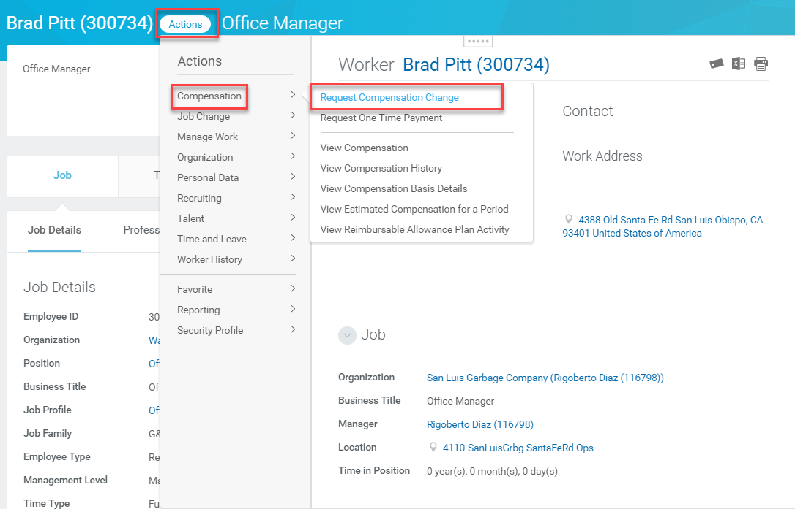
Compensation Changes
Click Actions
Hover over Compensation
Click Request Compensation Change.
Notes:
From the employee’s profile, click Actions. Hover over Compensation to access the drop-down menu and click Request Compensation Change.

Slide 8
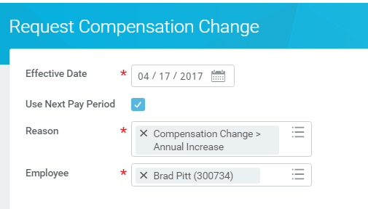
Compensation Changes
Click the Use Next Pay Period checkbox so the change goes in effect on the first day of the next pay period.
Select the effective date
Select the reason for the compensation change from the Reason field.
Select the Employee
Notes:
The Request Compensation Change page displays. Enter the date the change should go into effect in the Effective Date field. Typically, the effective date should be at the beginning of a pay period. For that reason, you can click the Use Next Pay Period checkbox so the change goes in effect on the first day of the next pay period. Select the reason for the compensation change from the Reason field. The employee’s name will default in the Employee field when the change has been initiated from the employee’s profile. Click OK.

Slide 9
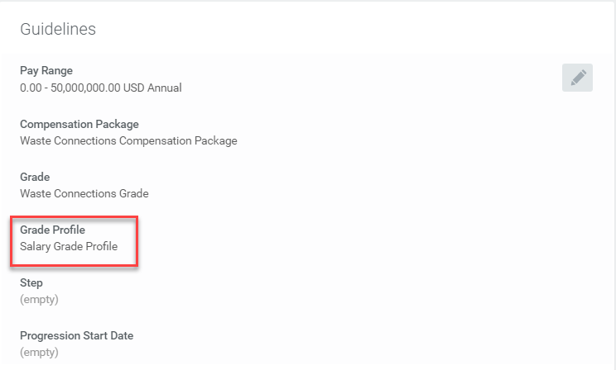
Compensation Changes…Salary Based Compensation Change
Make sure the Grade Profile reflects “Salary Grade Profile” for a salaried employee
Notes:
Start by reviewing the information in the Guidelines section of the page. “Salary Grade Profile” should be in the Grade Profile field.

Slide 10
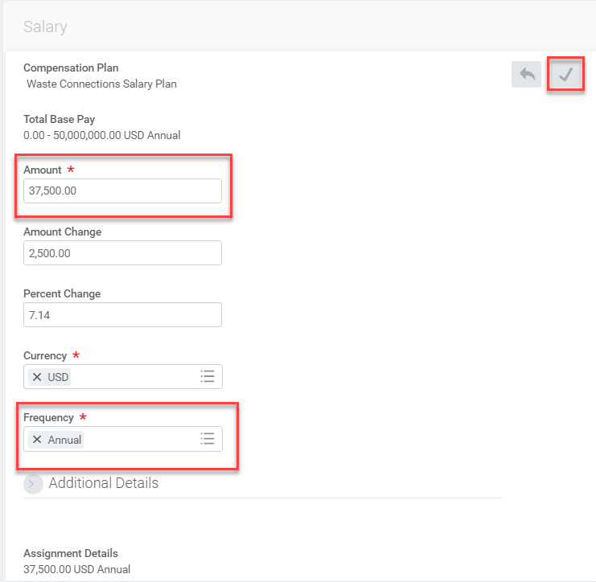
Compensation Changes…Salary Based Compensation Change cont.
Click the Edit icon and enter the details of the salary-based comp change
Once done, Click Save
Enter the new amount
You can also enact the change by entering amount changed or percentage changed
Make sure the appropriate frequency is selected
Notes:
Scroll down to the Salary section of the page. Edit the salary rate by clicking the Edit icon . Enter the new salary amount in the Amount field. You can also edit via a percentage change or amount change. Make sure “Annual” is selected in the Frequency field. Once done with all edits, click the Save icon .

Slide 11
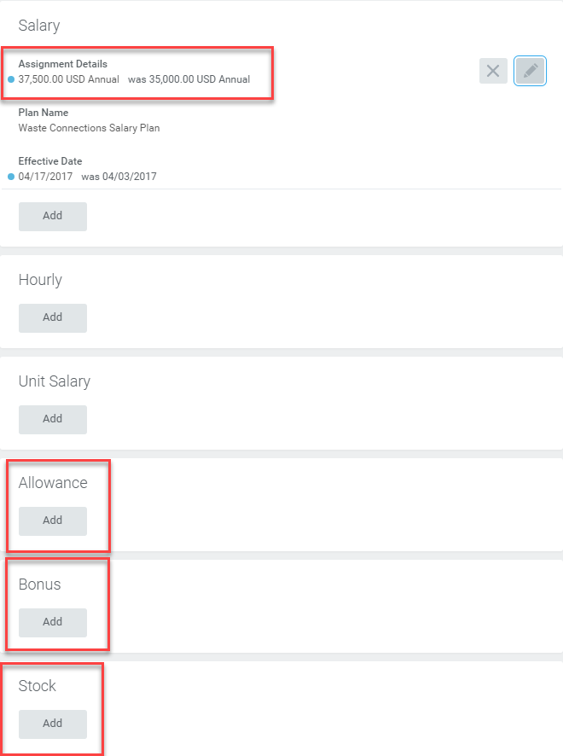
Compensation Changes…Salary Based Compensation Change…cont.
Assignment Details will show the new salary amount as well as the old salary amount.
Click Add and add or re-add any applicable Allowance (Auto), Bonus or Stock details When done, click Submit.
Notes:
Once the salary compensation change has been saved, the Assignment Details will show the new salary amount as well as the old salary amount. It is also very important to remember to click Add and add or re-add any applicable Allowance (Auto), Bonus or Stock details that are new or were assigned to the employee prior to the salary change. When done, click Submit.

Slide 12
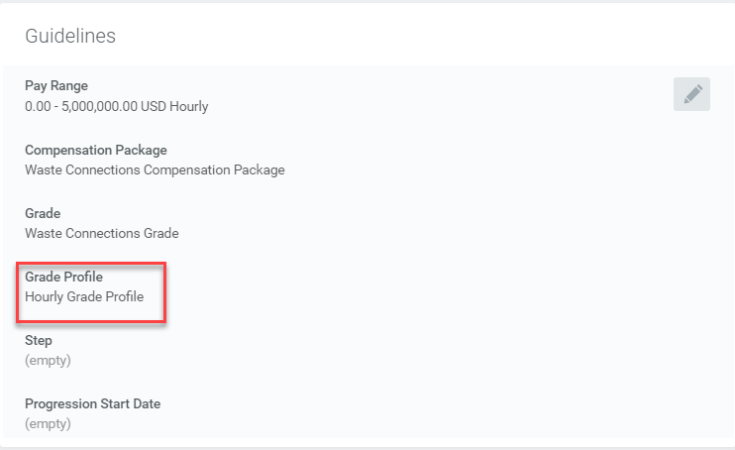
Compensation Changes…Hourly Based Compensation Change
Make sure the Grade Profile reflects “Hourly Grade Profile” for an hourly employee
Notes:
Start by reviewing the information in the Guidelines section of the page. “Hourly Grade Profile” should be in the Grade Profile field.

Slide 13
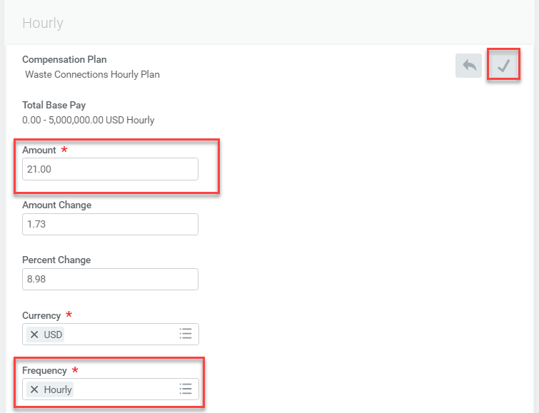
Compensation Changes…Hourly Based Compensation Change cont.
Click the Edit icon and enter the details of the hourly-based comp change
Once done, Click Save
Enter the new amount
You can also enact the change by entering amount changed or percentage changed
Make sure the appropriate frequency is selected
Notes:
Scroll down to the Hourly section of the page. Edit the hourly rate by clicking the Edit icon . Enter the new hourly amount in the Amount field. Make sure “Hourly” is selected in the Frequency field. The differential of the increase is reflected in the Amount Change and Percentage Change fields. Once done with all edits, click the Save icon .

Slide 14
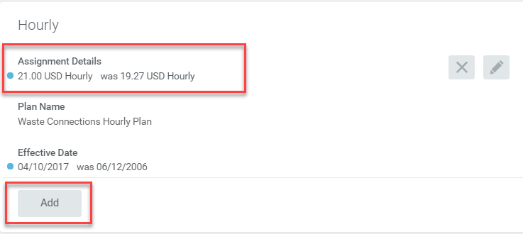
Compensation Changes…Hourly Based Compensation Change…cont.
Assignment Details will show the new hourly amount as well as the old hourly amount.
If necessary, Click Add and re-add the Vacation Rate for legacy Progressive employees
Notes:
Once the hourly compensation change has been saved, the Assignment Details will show the new hourly amount as well as the old hourly amount. It is also very important to remember to click Add and re-add the Vacation Rate for legacy Progressive employees if applicable.

Slide 15
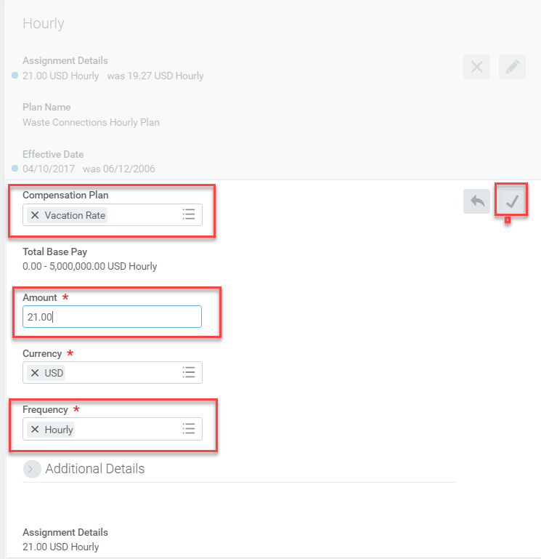
Compensation Changes…Hourly Based Compensation Change…cont.
Select “Vacation Rate” in Compensation Plan field
Click to save updates.
Enter the amount. It should be the same amount the employee is paid per hour
Select “Hourly” in the Frequency field
Notes:
It is also very important to remember to click Add and re-add the Vacation Rate for legacy Progressive employees if necessary. Select “Vacation Rate” in Compensation Plan field. The amount entered should be the same amount the employee is paid per hour and then select “Hourly” in the Frequency field. Once done with all edits, click the Save icon .

Slide 16
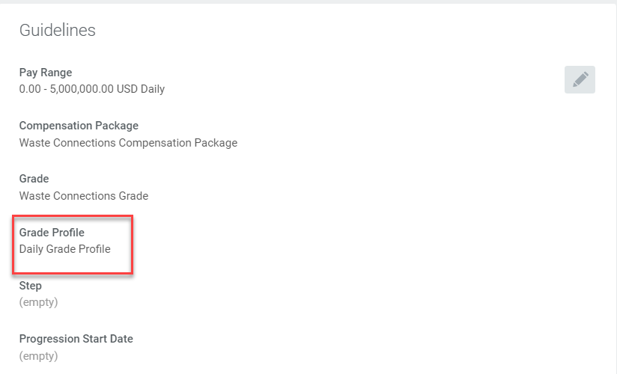
Compensation Changes…Daily Rate Based Compensation Change
Make sure the Grade Profile reflects “Daily Grade Profile” for a daily rate employee
Notes:
Start by reviewing the information in the Guidelines section of the page. “Daily Grade Profile” should be in the Grade Profile field.

Slide 17
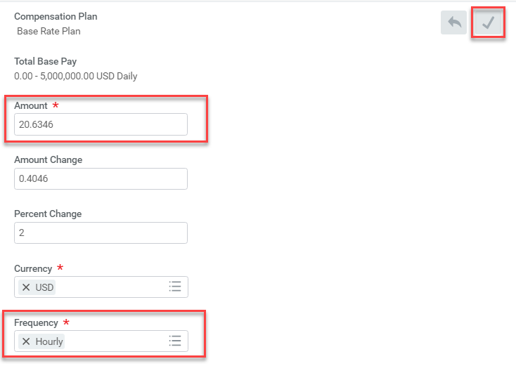

Compensation Changes…Daily Rate Based Compensation Change cont.
Enter the new amount
Once done, Click Save
Enter amount changed or percentage changed
Complete only if the employee is a legacy Progressive employee
Make sure the appropriate frequency is selected
Notes:
If the employee is a legacy Progressive employee, scroll down to the Hourly section of the page, edit the amount, make sure “Hourly” is selected in the Frequency field, and save the changes.

Slide 18
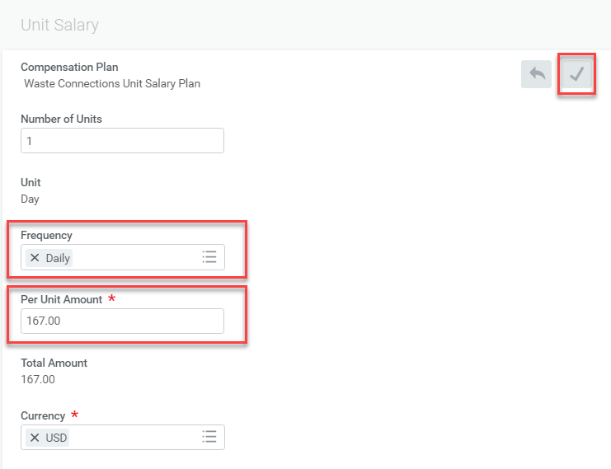
Compensation Changes…Daily Rate Based Compensation Change cont.
Complete for both legacy Progressive and legacy Waste Connections employees.
Save the changes
Make sure “Daily” is in the Frequency field
Enter the new amount in the Per Unit Amount field and save the changes.
Notes:
Next, scroll down to the Unit Salary section of the page and complete for both legacy Progressive and legacy Waste Connections employees. Make sure “Daily” is in the Frequency field and enter the new amount in the Per Unit Amount field and save the changes. Click Submit.

Slide 19
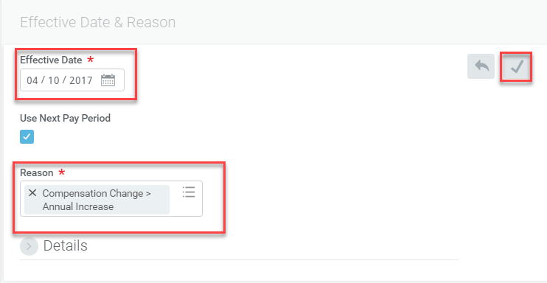
Compensation Changes…Incentive Based Compensation Change
Select the effective date
Click the Use Next Pay Period checkbox so the change goes in effect on the first day of the next pay period.
When done, click Save
Select the reason for the compensation change from the Reason field.
Notes:
Click the Edit icon in the Effective Date & Reason section of the page. Enter the effective date in the Effective Date field and the reason for the incentive compensation change in the Reason field. Click the Save icon.

Slide 20
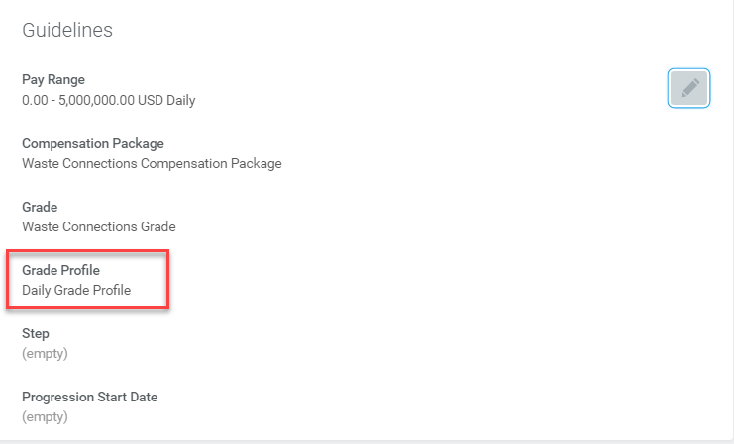
Compensation Changes…Incentive Based Compensation Change
Make sure the Grade Profile reflects “Daily Grade Profile” for an incentive rate employee
Notes:
Review the information in the Guidelines section of the page. “Daily Grade Profile” should be in the Grade Profile field for an incentive-based compensation change.

Slide 21
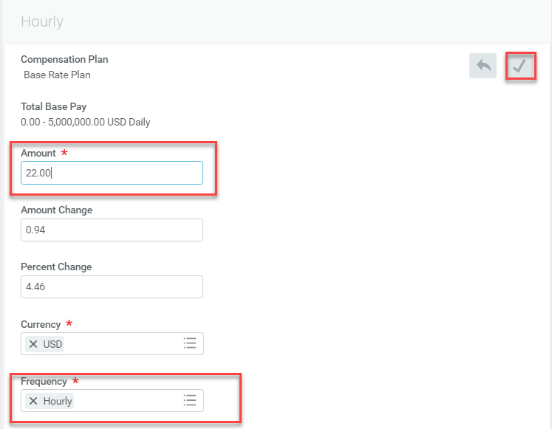
Compensation Changes…Incentive Based Compensation Change
Click the Edit icon and enter the details required in the hourly-based comp change screen
Once done, Click Save
Enter the new amount
You can also enact the change by entering amount changed or percentage changed
Make sure the appropriate frequency is selected
Notes:
Scroll down to the Hourly section of the page. Edit the hourly rate by clicking the Edit icon . Enter the new hourly amount in the Amount field. Make sure “Hourly” is selected in the Frequency field. The differential of the increase is reflected in the Amount Change and Percentage Change fields. Once done with all edits, click the Save icon .

Slide 22
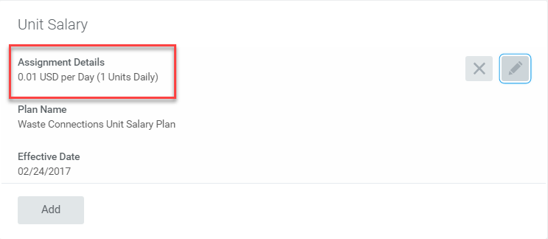
Compensation Changes…Incentive Based Compensation Change
The Per Unit Amount remains at 0 .01
The details in this section don’t change
Click Submit
Notes:
Because the Per Unit Amount does not change and remains at 0.01, no changes in thie Unit Salary section are typically necessary. Click Submit.

Slide 23
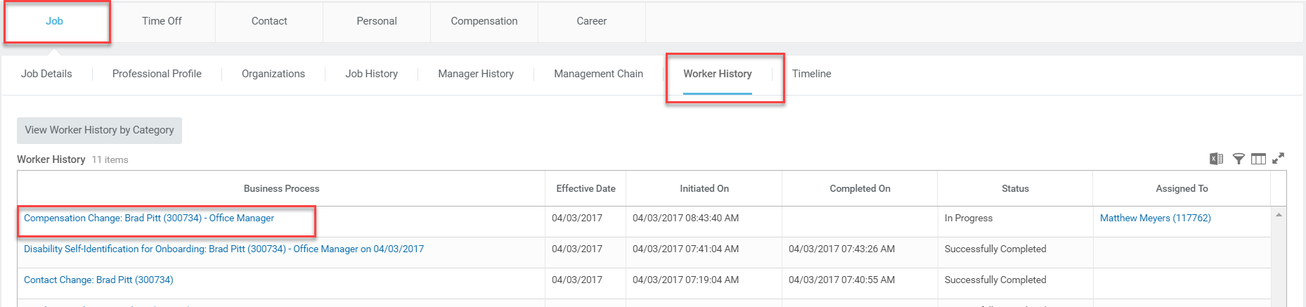
Compensation Changes…Check Status
Click the Job tab
Click the Worker History sub-tab
Click on the Compensation Change event
Notes:
Once compensation changes route for management approval, you can check the approval status from the employee’s profile. Click the Job tab and then click the Worker History sub-tab. Find the Compensation Change event under the Business Process column and click on it.

Slide 24
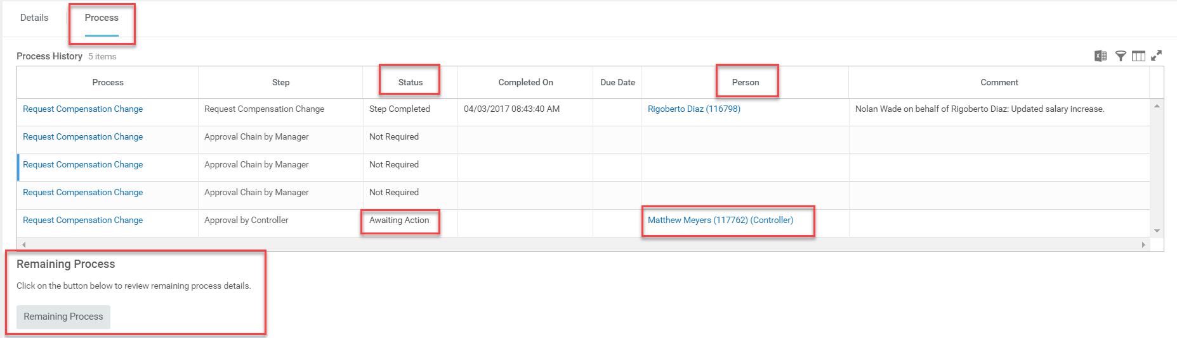
Compensation Changes…Check Status
Click the Process tab
Review the status of each step in the business process
Review the person responsible for a particular step
Click Remaining Process to see remaining steps in the business process
Notes:
The View Event page displays allowing you to see the details and processes associated with the compensation change. Click the Process tab to review the status of the change and the responsible person. To review the remaining approval processes, click the Remaining Process button.

Slide 25


Compensation Changes…Reminders
Compensation changes that include moving to a different compensation type typically require a job profile change. In such a case, a lateral transfer may be necessary. Not sure…reach out to your Payroll Analyst
If the compensation change dates back to 2016 prior to using Workday, please contact your payroll analyst to make sure the retro pay is calculated correctly

Slide 26

One-Time Payments
One-time payments are lump-sum amounts paid to employees in the form of bonuses, referral fees, relocation funds, severance, etc.
Notes:
Click on the Team Time worklet on your home screen.

Slide 27
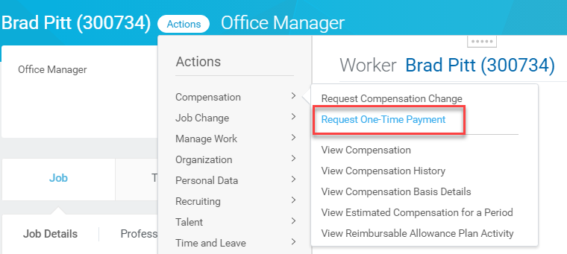
One-Time Payments…Request One-Time Payment
Click Actions
Hover over Compensation
Click Request One-Time Payment
Notes:
From the search bar, enter the “request one time payment” task. You can also access this task from the Employee’s profile by clicking Actions and hovering over Compensation. Click Request One-Time Payment from the drop-down menu.

Slide 28
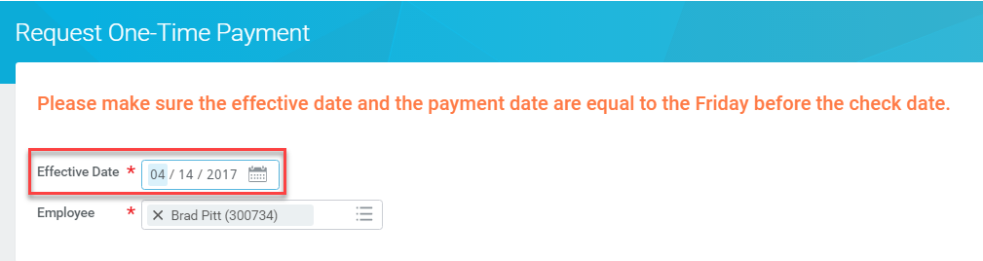
One-Time Payments…Request One-Time Payment cont.
Enter the effective date
Select the employee
Notes:
Enter the effective date and the employee name. Be sure to enter a date that is the Friday before the date checks are paid to employees.

Slide 29
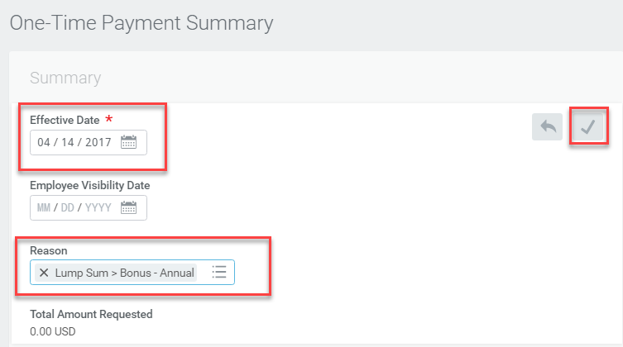
One-Time Payments…One-Time Payment Summary
Effective Date defaults
Select Reason for the one-time payment
Click to save updates
Notes:
The One-Time Payment Summary page displays. Click the Edit icon . The Effective date defaults which is the Friday prior to the check date. You may enter the Employee Visibility Date as the date the employee receives the funds on his/her paycheck. Select a reason for the one-time payment from the Reason field. Once done, click the Save icon

Slide 30
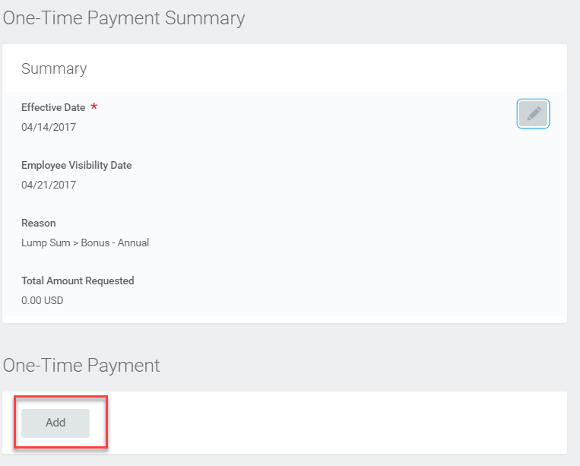
One-Time Payments…One-Time Payment Details
Click Add to enter one-time payment details
Notes:
Once the summary information has been saved, enter the one-time payment details by clicking Add.

Slide 31
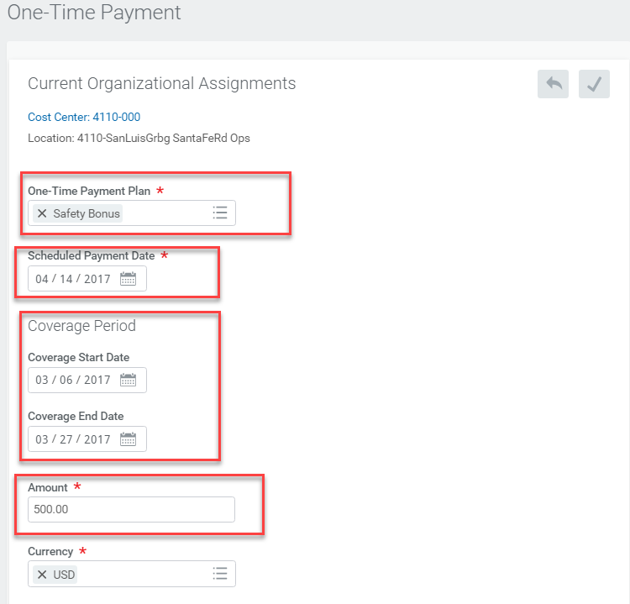
One-Time Payments…One-Time Payment Details cont.
Choose the One-Time Payment Plan
The Scheduled Payment Date is the same as the Effective Date
Enter the coverage period for which the one-time payment is awarded
Enter the amount of the one-time payment
Notes:
Choose the One-Time Payment Plan type and enter the amount. Note that the Scheduled Payment Date is the same as the Effective Date. Remember, these dates need to be the Friday before the date checks are paid to employees.

Slide 32
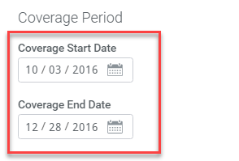
One-Time Payments…Coverage Dates for FLSA Qualifying Bonuses
When entering a one-time FLSA payment, the coverage dates can span a pay period, an entire month, quarter or a year.
Notes:
When entering a one-time FLSA payment, Enter the Coverage Period which is the timeframe or pay period in which the bonus was earned. The coverage dates can span a pay period, an entire month, quarter or a year.

Slide 33
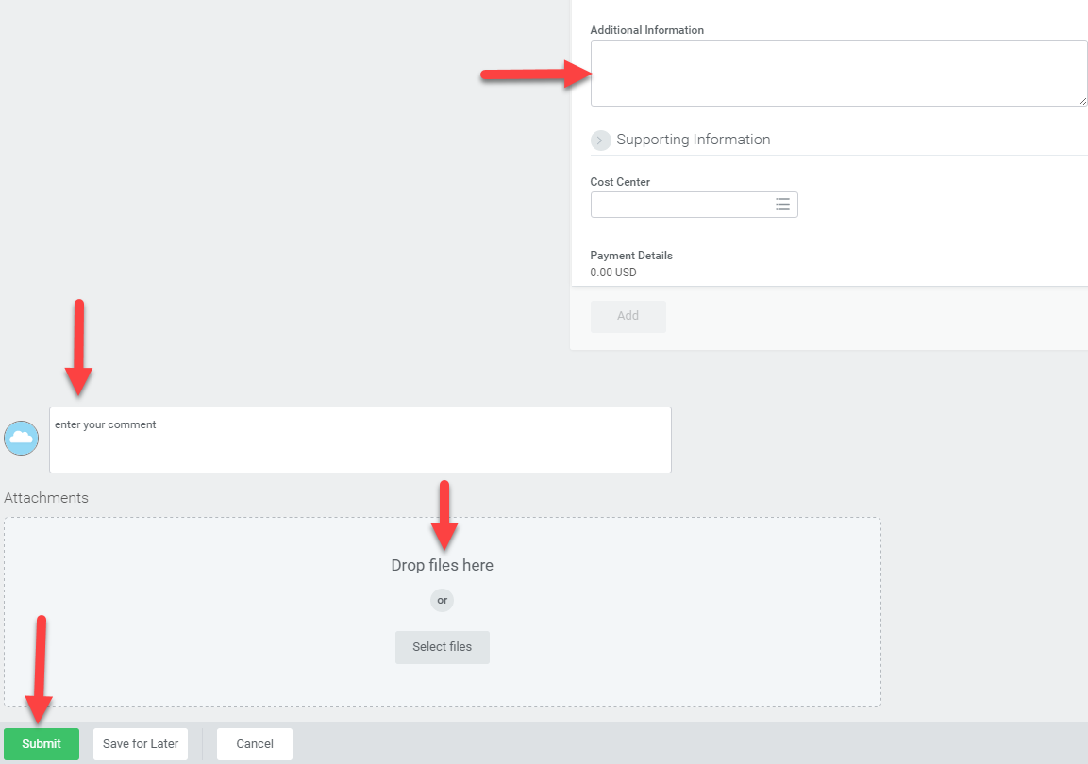
One-Time Payments…One-Time Payment Details cont.
Add any relevant information regarding the one-time payment
Add any general information in the comments section
Attach any relevant files
Click Submit
Notes:
Use the Additional Information field for details relevant to the one-time payment and upload any supporting documentation required by your region. You may also add any general comments in the “enter your comment” section. Click Submit.

Slide 34

Demonstrations

Slide 35

Resources
Job Aids Currently Available in the Learning Worklet:
Request Compensation Change
Process One-Time Payment Job Aid

Slide 36
THANK YOU!!

